Slide 1
LF AI & Data: Accelerating Development and Innovation in the Open Source AI and Data Domains
September 2021
Ibrahim Haddad, Ph.D.
Executive Director, LF AI & Data
Ibrahim@LinuxFoundation.org

Slide 2
Introduction to Linux Foundation

Slide 3
The Linux Foundation’s goal is to create the greatest shared technology investment in history by enabling open collaboration across companies, developers and users.
We are the nonprofit organization of choice to build ecosystems that accelerate open source technology development and commercial adoption on a global scale.

Slide 4
































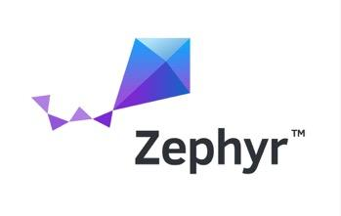













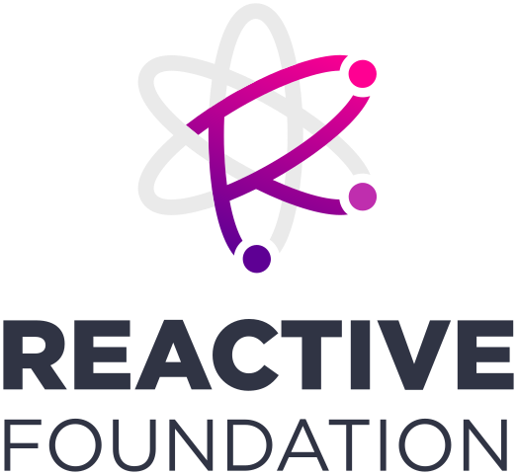





































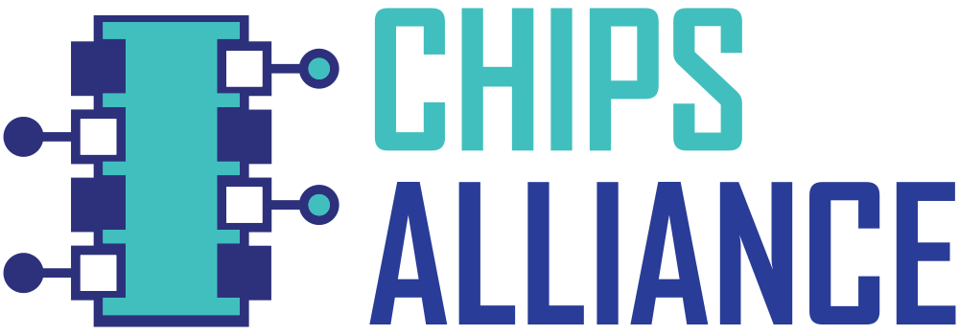









We are behind some of the most critical projects in the world
Security
Networking
Cloud
Automotive
Blockchain
Edge/IoT
Web
AI
Film
CI/CD
Energy
Hardware
Standards

Slide 5





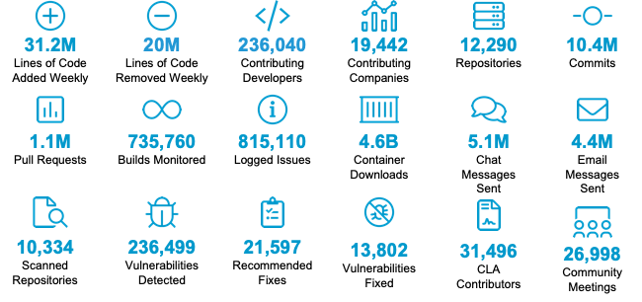
Building large, sustainable ecosystems requires collective resources
2000+
100%
242,960+
730+
$54.1B
Members From 41 Countries
of Fortune 100 Tech & Telecom
Developers Contributing Code
Critical Open Source Projects
Shared Value
The Linux Foundation is a critical part of modern technology

Slide 6
For an Enterprise, Open Source is about Business Strategy

Slide 7


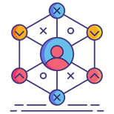

Open Source Strategic Impact
Accelerate the development of open solutions
Provide an implementation to an open standard
Commoditize a market
Reduce prices of non-strategic software assets
Share development costs
Drive demand by building an ecosystem for products & services
Partner with others
Engage customers
Strengthen relationships with common goals

Slide 8
Increase market opportunity
If a certain part of our stack became a commodity and every player adopted it, where can we get first mover and industry leader advantages to expand our market opportunity?
Are there open, industry adopted southbound or northbound APIs to allow for interoperability and/or data egress/ingress?
Where can we increase customer value with offerings of additional data services, analytics, management, and security? What industry open source base stack can facilitate this?

Slide 9
Take market share through de facto standards
Where in the stack can we disrupt a market leading proprietary implementation with a standardized open source implementation that creates a market opportunity for us?
Which peers, partners and suppliers, do I need to involve to ensure an open source effort becomes adopted industry-wide?
Where can a customer or competitor use open source to create a de facto standard that forces us to change our product development roadmap and R&D/IT investments?

Slide 10
Decrease costs
Where is there opportunity to externalize commodity R&D through shared open source development?
Where is the client shouldering duplicative costs in non differentiating vendor solutions and how we can we use open source to move our relationship up the stack while removing duplicative R&D?

Slide 11
Strategy is Built Upon Category Creation through EcoSystem Formation and Industry-Wide Standardization on Open Source Software

Slide 12
Open Source enables companies to reshape their industry value chain in ways that are both neutral (to create Industry Platforms) and that drive their own competitive goals (through active Stakeholdership)

Slide 13
Old World “Standards” = Specifications with Divergent Implementations
New World Standards = Industry-wide adoption of shared technology development and critical deployment alongside specifications to become a de facto platform

Slide 14
Stakeholders invest in active, multi-year Membership to see hundreds of millions, sometimes billions, in return by collecting value from Industry Platforms

Slide 15

“You are either at the table or on the table. “ -Anonymous Executive
Notes:
Talking Points:
As one anonymous executive said to me recently…...

Slide 16


Open Source Journey – First Came Projects
Projects
PROJECTS
Successful Open Source Development depends on the complete life cycle of projects, products that market will adopt and deploy
DEVELOPER
COMMUNITY
TECHNOLOGY
PARTICIPATION
PROFITS
PRODUCTS
MARKETS
PRODUCTS
Deployments
Notes:
Project require value (disruption – 5G, IOT, Edge, savings, new services, Demand, … )
Neutral Governance, community to enable collaboration

Slide 17
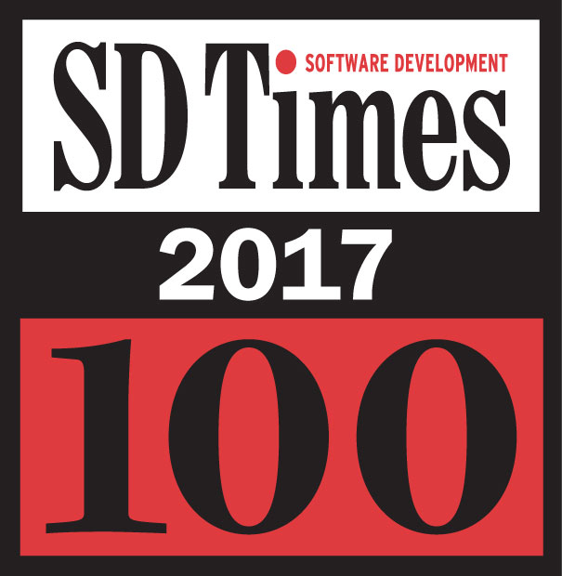
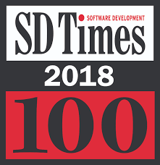
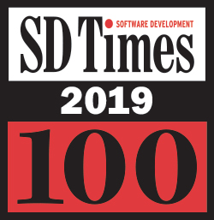
Our Role Has Been Recognized Alongside Tech Titans
› “This category looks at those companies, associations and projects that have inspired development and IT shops to build upon the work they have created, and recognizes them for their leadership as we begin to create a digital world we only could have dreamed about a generation ago.
› SD Times Influencers: Apple, Facebook, Google, IBM, Intel, Microsoft, GitHub, Netflix, Red Hat, Slack, The Linux Foundation
In 2019, The Linux Foundation is the Only Non-Profit Recognized For Three Consecutive Years For Its Critical Role in the Industry

Slide 18
The Linux Foundation Platform assists projects in 5 key areas
Governance and Membership
Project technical governance, policies, etc.
Ongoing business development and membership recruitment
Membership management
Development Methodology and Processes
Technical decision making
Project life cycle
Release processes
Infrastructure
CI/CD infrastructure using open source best practices
Release engineering, DevOps
Security and reliability
Ecosystem Development
Evangelism, marketing and outreach initiatives
Events bringing developers, users and solution providers together
Training for developers and administrators, establishing professional certifications
IP and Assets Management
Code provenance
Trademark management
IP Policy, license scanning, IP defenseas
Notes:
MG: Fix/Study

Slide 19







Building large, sustainable ecosystems require collective resources
Events
Legal
Training
Certification
Developer Marketing
Developer Operations
Application Security
We gathered over 35,000 attendees from over 11,000 organizations across 113 countries in 2018
We manage IP for the world's most important tech and have some of the world's top source legal team in house
We have trained millions of students through free and paid online training, online skills certification, and on site e-learning
We have designed and implemented both software and hardware testing and certification programs
We have the largest share of voice of any open source foundation and a proven method to build large scale developer programs
We host the infrastructure that develops the world's largest software communities and provide release mgmts., IT ops and support
In addition to massive peer review, our projects our regularly audited and pen tested. We offer bug bounties, dependency analysis, and code scanning.

Slide 20

We enable you become open source leaders
Leader
Contributor
Participant
Consumer
Leveraging Open Source for your Business Strategy

Slide 21



We help you navigate open source
Our services help companies manage open source strategically.
We host the world’s most
important projects.
Our events are the place
where top developers and users of open source meet.
Our training programs meet
the demand for OSS skills from the source.
Project
Hosting
Networking
Events
Technical Training
Open Source
Research
Launching
New
Projects
Technical Mentorship
Membership Services

Slide 22
Who is LF AI & Data?
The LF AI & Data is a global not for profit foundation that hosts critical components of the global AI & Data technology infrastructure. It brings together the world’s top developers, end users, and vendors to identify and contribute to the projects and initiatives that address industry challenges for the benefit of all participants.

Slide 23
LF AI & Data Mission
Our mission is to build and support an open AI community, and drive open source innovation in the AI, ML, DL and Data domains by enabling collaboration, sharing best practices, supporting development efforts, and the creation of new opportunities for all the members of the community

Slide 24
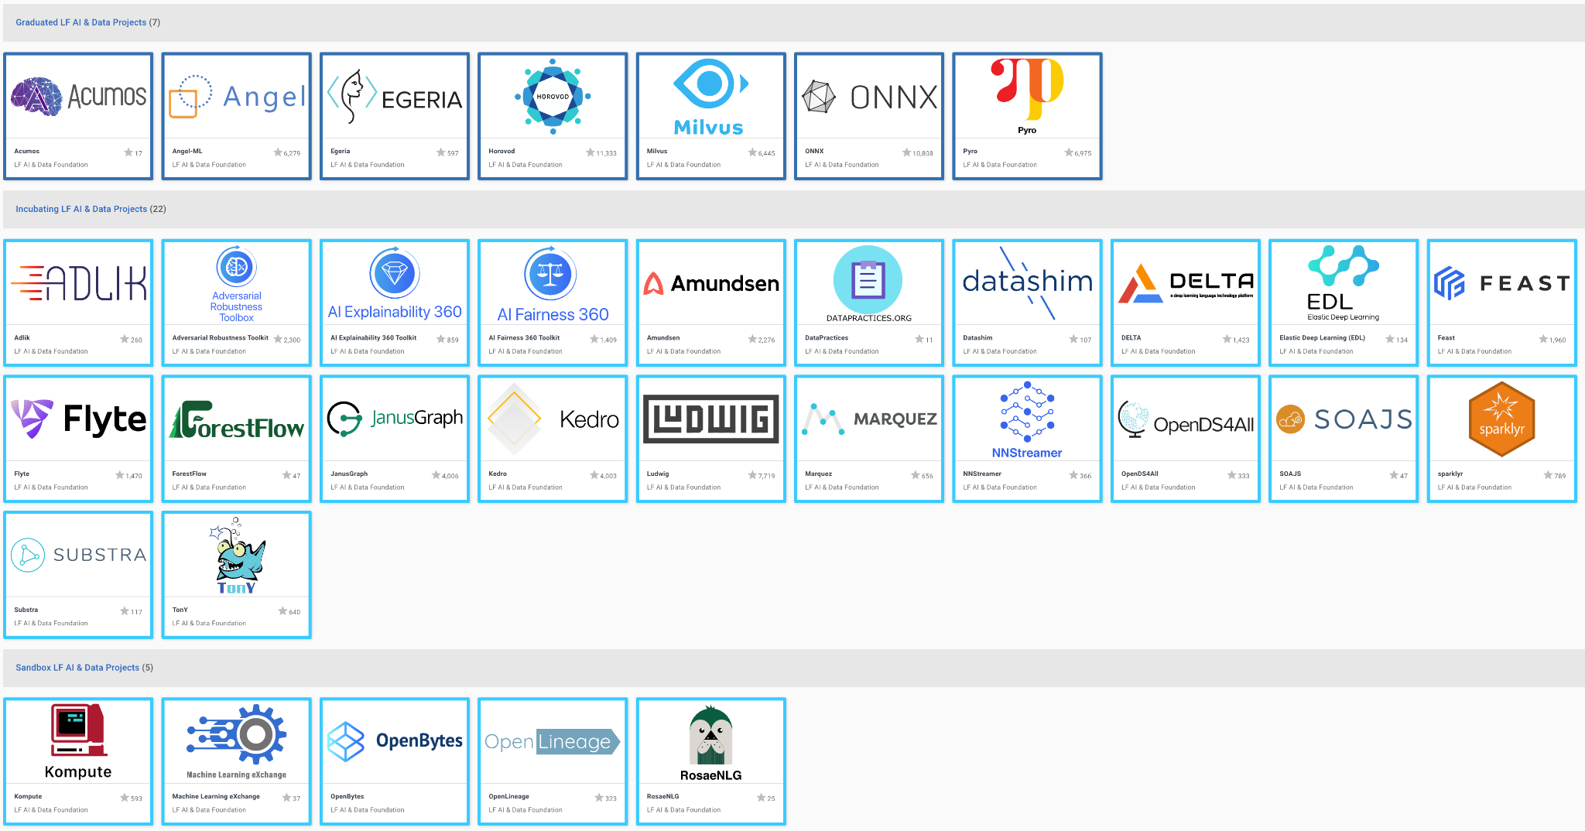
LF AI & Data Hosts Leading Open Source AI & Data projects

Slide 25
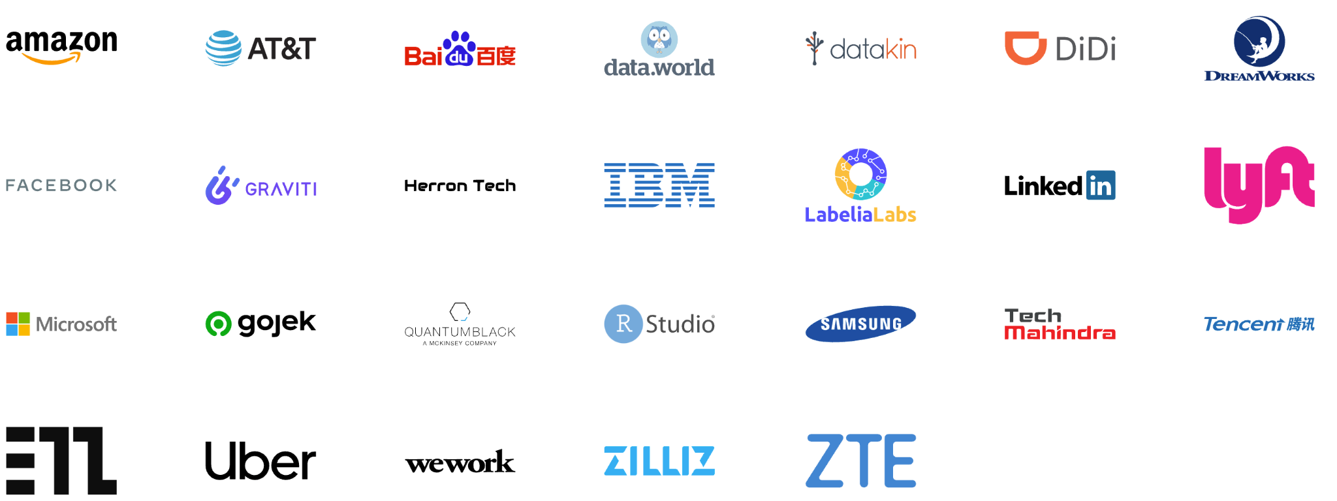
Industry Leaders Host Their Projects in LF AI & Data

Slide 26








LF AI & Data has Unprecedented Momentum
Supporting 51 members
Hosting 34 Projects
Managing IT Infrastructure (incl. cloud) 35 GitHub Orgs (311 repos)
Managing legal assets, trademark, export control filings, compliance scans
A growing community of over 18K active developers with own events
Major efforts: BI & AI, DataOps, Trusted AI, ML Workflow & Interop
Adding one new project and one new member a month for the past 24 months

Slide 27

Why incubate your project with LF AI & Data?
Building large, sustainable ecosystems requires collective resources
Neutral Hosting with technical open and neutral governance model
Dedicated staff - Access to full-time staff (ED, PM, Tech) with program and project management services
Training & Certification - We build training classes, design and execute and testing and certification programs in support of hosted projects
Events team - Access to a full range of events services to help the project build and grow a community around it
Developer Operations - LFX platform, IT infrastructure, release management, IT ops, support, security audits, etc.
Endorsement & mentorship by members of the LF AI & Data Technical Advisory Committee
Marketing and communications services to support community and ecosystem engagement
Legal support - including hosting the trademark, CLA and DCO integration with GitHub, compliance scans, export control filings, etc.

Slide 28
LF AI & Data Structure and Governance
Foundation Governance
(Funding effort)
Technical Coordination
Hosted
Projects
Governing Board
Technical Advisory Council
Outreach
Legal
ML Workflow & Interop
Trusted
AI
Strategy
Budget
BI & AI
DataOps
‹#›

Slide 29
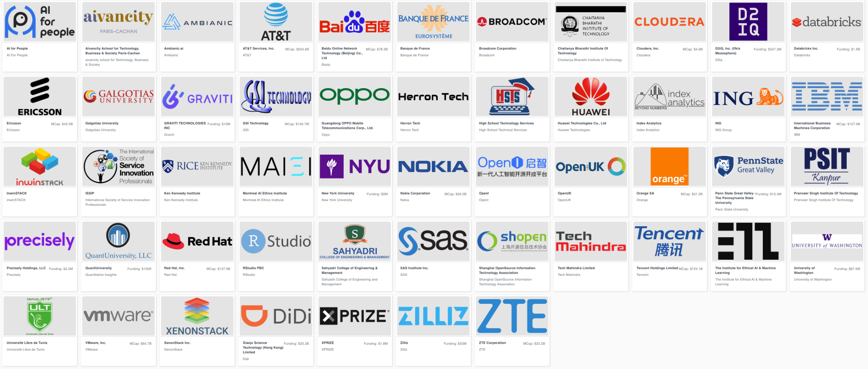
LF AI & Data Members

Slide 30
Ecosystem Overview

Slide 31
Open source libraries, frameworks, platforms, tools, are a two-way street: they make AI accessible to everyone, and companies benefit from a community of other contributors helping accelerate open AI applied research.
Notes:
Barrier to entry in AI has been lowered

Slide 32
The barrier to entry in AI is lower than ever before, thanks to open source software.

Slide 33
Open Source offers unique benefits to AI & Data
Fairness
Methods to detect and mitigate bias in datasets and models, including bias against known protected populations
Robustness
Methods to detect alterations/tampering with datasets and models, including alterations from known adversarial attacks
Explainability
Methods to enhance understandability and interpretability by persona/roles in process of AI model outcomes/decision recommendations, incl ranking & debating results and decision options
Lineage
Methods to ensure provenance of datasets and AI models, including reproducibility of generated datasets and AI models
Open Data
Data licensed under an open source data specific license making it freely available for use without mechanisms of control
Data Manipulation Tools
Tools to clean, sort, tagg, track provenance, etc., and a governance structure for doing these thing

Slide 34

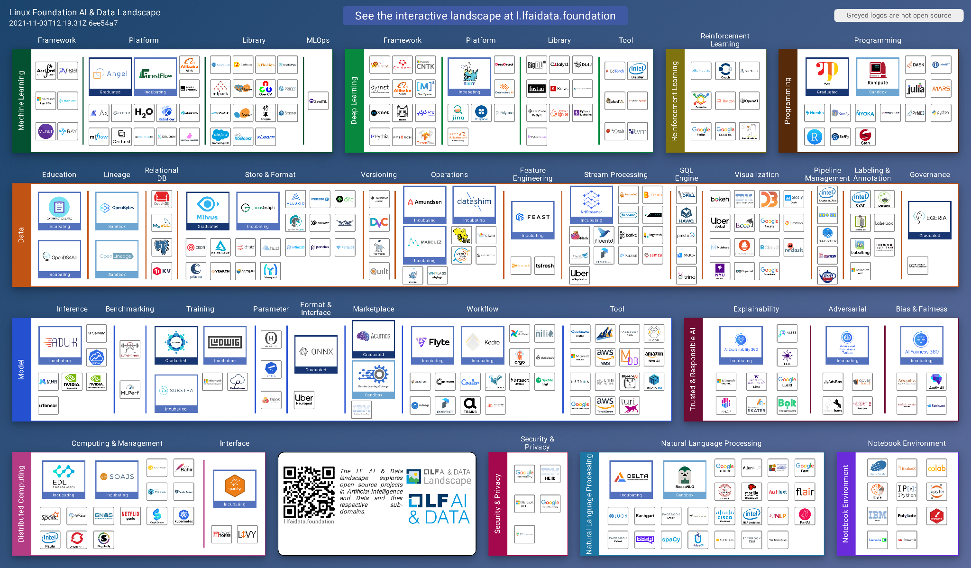
A growing ecosystem
https://l.lfaidata.foundation
316 projects
2.2M+ GitHub Stars
450M+ LoC
40K+ developers
140+ founding orgs
10+ universities
13 licenses
>450M LoC
>1M new LoC weekly

Slide 35
But with challenges
Glass ceiling for project investment and adoption
in the absence of a fair governance and safe haven for the project’s assets
1
Managing projects assets
As project grows, it is unclear who should own legal and administrative tasks that are essential to the health of the project
2
Developed internally for specific product requirements, highly specialized
The open source spinoff is a result of wanting to build an ecosystem and collaborate on building a platform
3
Governance challenges
No formal governance,
governance favors the creators of the project,
project backer dominating dev and governance
4
Fragmentation
Lack of integration
Lack of cross pollination
5

Slide 36
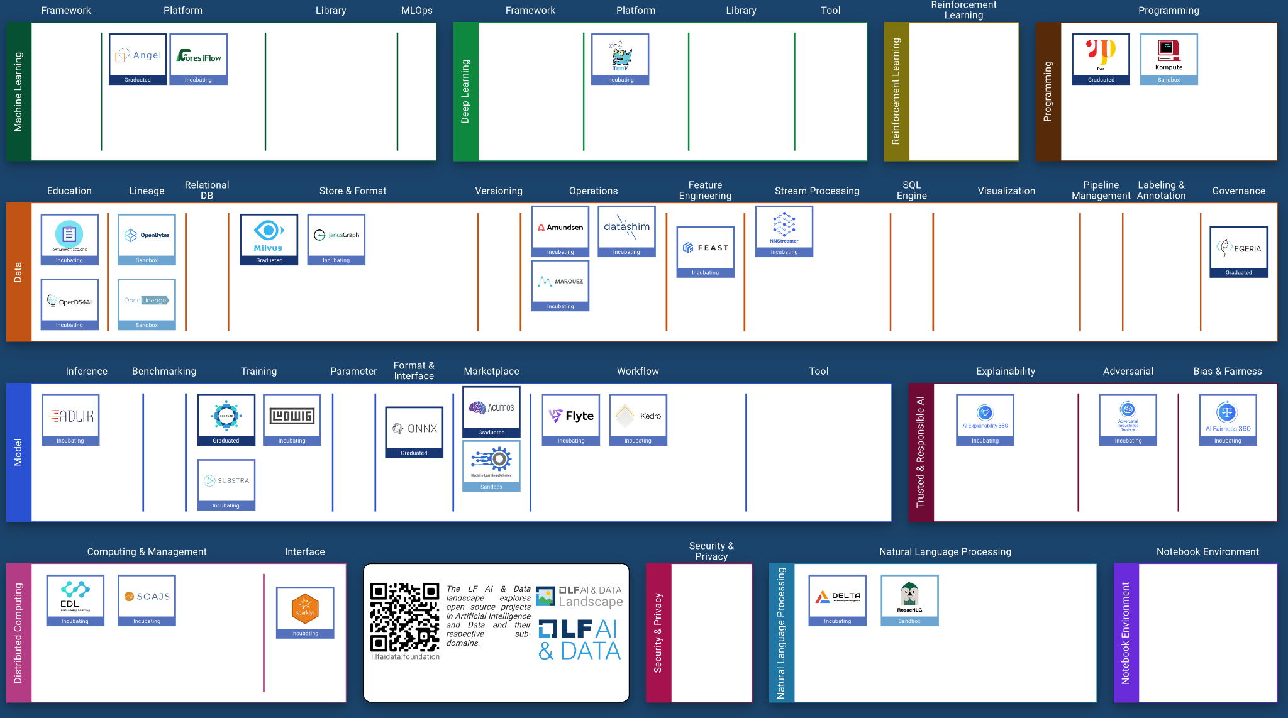
Over 10% of the ecosystem’s key projects depend on LF AI & Data for their open governance, safe haven for their assets, infrastructure, and enabling marketing, legal and event services

Slide 37
LF AI & Data Developer Community

Slide 38
Active and growing developer community
Jan 1- Dec 31, 2020
8.92K
100.03K
358
6.93K
34.65K
22.54K
Contributors
Commits
Repositories
Emails
PRs/Changesets
Total issues
Source: https://insights.lfx.linuxfoundation.org/projects/lfai

Slide 39
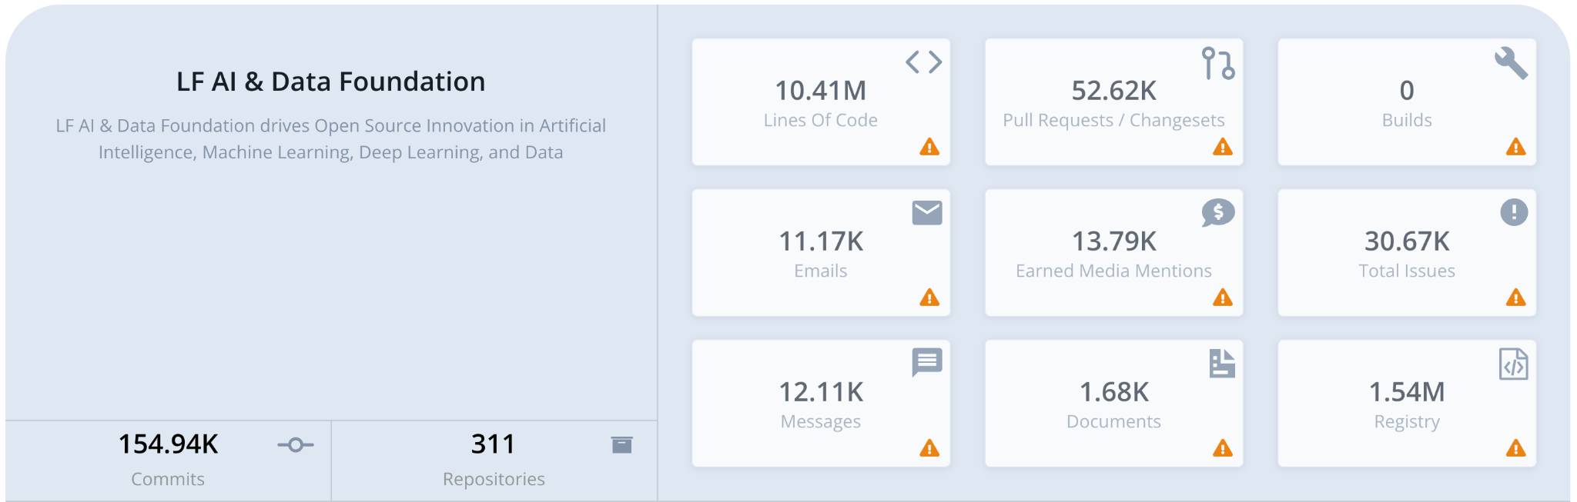

Double Digit Growth YoY
Source: https://insights.lfx.linuxfoundation.org/projects/lfai
Data as of 10/21

Slide 40
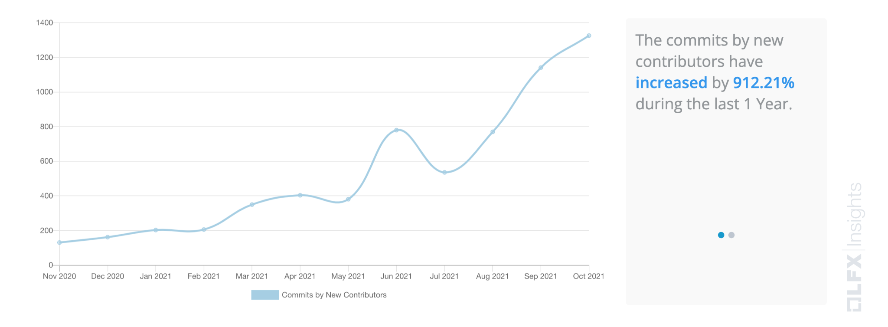
Commits by New Contributors
New contributors are defined as those who did their first commit during the selected time period.

Slide 41
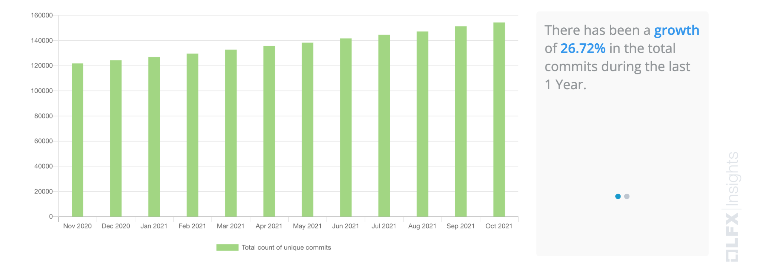
Commits Growth
The growth in term of the aggregate count of total number of unique commits during the selected time period.

Slide 42
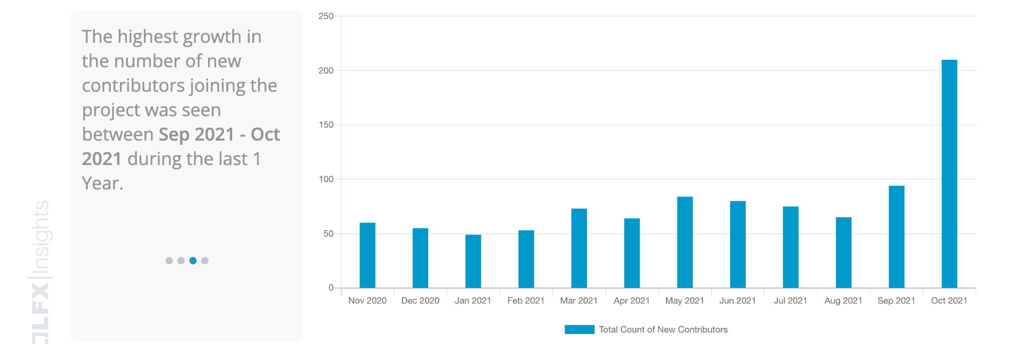
New Contributor Growth
A new contributor is defined as someone who performed their first code activity during the selected time period.

Slide 43

Focused Developer & Community Marketing Effort
MarComm services to support community and ecosystem engagement
37 announcements in 2019
61 announcements in 2020
45 announcements in 2021 (Jan - Sept)
Events and community ecosystem building services
Community events
6 in 2019
8 in 2020
6 in 2021
Major conferences
3x LF AI & Data Summit (NA, EU, China)
AI Track at KubeCon, collab with CNCF
LF AI & Data Day (multiple/year)
Kubernetes + AI, collab with CNCF
AI Track, Open Networking & Edge Summit, collab with LF Edge
Events and promotion
Project
incubation
Project
graduation
Project
releases
Project cross collaboration

Slide 44






























Data Coverage (June 7, 2021) - Line of Code and Commits
1200K
200K
Lines
60K
Substra Framework
1K
6K
20K
Commits
Notes:
Based on data from:
https://insights.lfx.linuxfoundation.org/projects/lfai
https://landscape.lfaidata.foundation/format=card-mode

Slide 45
Data Coverage (June 7, 2021) - Stars and Contributors
11K
2K
GitHub
Stars
0.4K
Substra Framework
0.3K
0.7K
6.2K
Contributors
Notes:
Based on data from:
https://insights.lfx.linuxfoundation.org/projects/lfai
https://landscape.lfaidata.foundation/format=card-mode

Slide 46
LF AI & Data Membership Benefits
LF AI & Data is positioned to bolster cross-company collaboration and interoperability with our neutral IP zone, rich contributor programs, and most importantly, the trust end users place in us

Slide 47
Organizations join LF AI & Data to take an active role in supporting the growth and evolution of the Open Source AI & Data ecosystem
Support our mission, programs, and the community by helping fund services that hosted projects rely on
Demonstrate thought leadership by participating in a wide reaching networking and marketing programs
Be part of defining and maintaining technologies that are at the forefront of the industry
Host projects with us and benefit from the services & support we offer our hosted projects to increase their adoption and footprint in the ecosystem
Provide technical leadership to the community via the TAC, it various sub-committees and efforts
Receive greater insight into the foundation’s strategy, efforts, projects and initiatives through increased engagement with the ED, staff and committees’ leads

Slide 48

LF AI & Data Membership Benefits
Marketing Amplification & Brand Awareness
Community Engagement
Thought & Tech Leadership Across Key Technologies

Slide 49




Marketing Amplification and Brand Awareness
Broaden your reach and awareness in the community with LF AI & Data marketing programs. As a member you can participate in:
LF AI & Data Outreach Committee
Participate in the marketing committee monthly to engage with your peers in the cloud native space.
LF AI & Data Online Programs
Showcase your organization’s open source technology by educating new and existing community members about best practices, trends, and new technologies
LF AI & Data Blog
Showcase your thought-leadership and industry commentary, as well as share technical walkthroughs for LF AI & Data projects here.
LF AI & Data Summit
LF AI & Data organizes its own community’s open source developer summits focused on open source AI and Data technologies.
Public Relations & Analyst Relations Support
LF AI & Data supports members with analyst reports and research highlights.

Slide 50
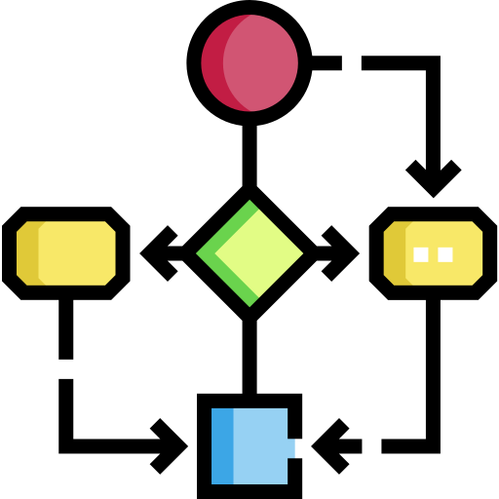



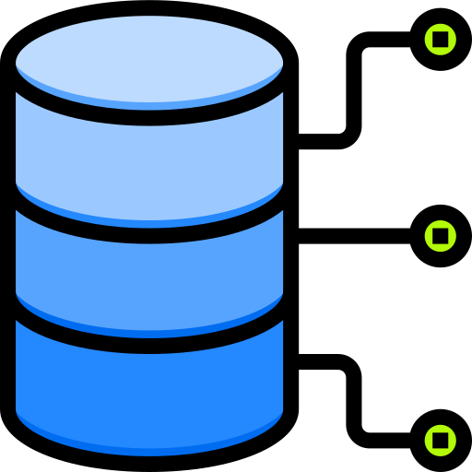
Community Engagement
LF AI & Data is a constellation of open source projects. Our members leverage many efforts to engage with our project’s ecosystems and share their stories. As a member you can participate in:
ML Workflow and Interoperability
Design a reference architecture for end-to-end ML Workflow and provide a reference implementation using hosted projects. facilitate integration and interop across projects.
Trusted AI
A global group working on policies, guidelines, tools and use cases by industry to ensure the development of trustworthy AI systems and processes to develop them continue to improve over time.
DataOps
Share best practices, and bring technology awareness around DataOps across industries and enable collaboration across LF AI & Data member companies, projects, and external participants leading to increased innovation.
BI & AI
Integrate the power of AI and BI to make it CI (Cognitive Intelligence) by combing the speed machines accelerate (AI) with the direction intuited by human insight (BI).
LF AI & Data Day
A 1-day event organized multiple times per year focused on specific technical projects and collaboration ongoing in LF AI & Data

Slide 51


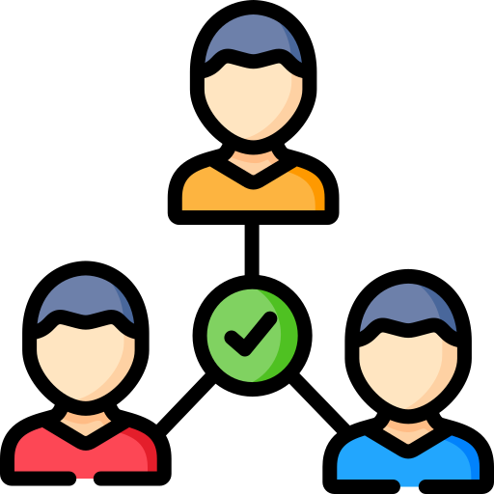

Thought Leadership
Members of the LF AI & Data can network and help shape the open source AI and Data market.
As a member you can participate in:
Governing Board Participation
Participate in elections to serve on the Governing Board to oversee the vision of LF AI & Data and work with the TAC.
Engagement with other Foundations and Industry Consortia
Participate in establishing collaborations with other umbrella foundations under the LF and broadly with other industry consortia organizations.
Technical Advisory Council Leadership
LF AI & Data TAC provides technical leadership to the open source AI and Data community, accepts projects into incubation, graduates projects and launches new efforts and collaborations.
Interactive Landscape Placement
Our landscape is a comprehensive view of all open source AI and Data critical projects in the ecosystem. Anyone looking to adopt open source AI and Data projects comes here to review what technologies they should assess and adopt.

Slide 52
LF AI & Data Annual Dues
Not Yet a Linux Foundation Member
Existing Linux Foundation Member
Premier Member
$120,000
$100,000
General Member
5,000 employees +: $45,000
2,000 - 4,999: $30,000
500 - 1,999: $25,000
Up to 499 employees: $10,000
5,000 employees +: $25,000
2,000 - 4,999: $15,000
500 - 1,999: $10,000
Up to 499 employees: $5,000
Associate Member
Free
Limited to academic and nonprofit institutions respectively and requires approval by the Governing Board

Slide 53

Premier Membership
Highest tier of membership – For organizations contributing heavily to open source AI and Data, and bringing their own projects to be hosted at the Foundation. They work in concert with the Foundation team members. These companies want to take the most active role in enabling the open source AI and Data ecosystem.
Premier members are eligible to:
(Enjoy all the benefits of General level, plus;)
Hold one (1) guaranteed seat on the LF AI & Data Governing Board + one alternate (1) representative
Appoint one (1) voting representative in any subcommittees or activities of the LF AI & Data Governing Board
Receive greater insight into LF AI & Data strategy and projects through engagement with the LF AI & Data leadership team. Premier level members have the unique opportunity to customize their experience with LF AI & Data. The team will make themselves available to help achieve your strategic goals. We can help with guidance in open source contributions, new market creation, and/or open source project donation. Have ideas? Just ask!
Enjoy most prominent placement in displays of membership including website, landscape and marketing materials.
Create an individualized press release upon membership announcement with the LF AI PR team.

Slide 54

General Membership
Targeted for organizations that want to put their organization in full view in support of LF AI & Data and our mission. Organizations that join at the General level are deeply committed to using open source technology, helping LF AI & Data grow, voicing the opinions of their customers, and giving back to the community.
General members are eligible to:
Participate in elections between only other Gold members to appoint one (1) representative to the LF AI & Data Governing Board. Three (3) total Gold representatives will be elected to represent all Gold members. Voice your opinions amongst the leaders in the industry and help determine the strategic direction of LF AI & Data.
Receive greater insight into LF AI & Data strategy and project roadmaps through increased engagement with the LF AI & Data Executive Director and staff.
Create an announcement upon membership announcement with the LF AI & Data PR team.
Participate in all Marketing, Community, Thought Leadership opportunities.
Opportunity to host “LF AI & Data Day”, including on-demand webinars and livestream.
Receive discounts on LF AI & Data event sponsorships.
Demonstrate your support for LF AI & Data by displaying your logo on the LF AI & Data website, landscape and in marketing materials.

Slide 55

Associate Membership
The Associate membership is a free complimentary membership limited to academic and non-profit institutions.
Associate members are eligible to:
Participate in all Marketing, Community, and Thought Leadership opportunities.
Identify your organization as a member and display your logo on the LF AI & Data website, landscape and in marketing materials.
Feature your organization in the quarterly new members announcement.
Receive discounts on LF AI & Data events’ sponsorship.
Specific opportunities for associate members:
Practical experience working with open source foundations
Visibility into and within the ecosystem
Internships opportunities with commercial members
Collaboration opportunities
Publication opportunities based on R&D conducted with projects
Open source working experience for all participants
Access to LF AI & Data events

Slide 56
Getting Involved in LF AI & Data

Slide 57

Getting involved with technical projects
Participate in the development: Review and submit patches, report bugs, request features, test, etc.
Attend developer events for LF AI & Data projects
Contribute to project documentation
Provide your testing and deployment feedback via appropriate project channel
Join the projects’ mailing lists and participate in the discussions
Start a local User Group Meetup

Slide 58
Getting involved with the Technical Advisory Council
Support TAC leadership in inviting speakers to present for the LF AI & Data technical community
Attend TAC Bi-weekly calls, participate in the discussions
Share success stories, opportunities and challenges in relation to open source AI with the broader technical community
Identify opportunities for collaboration on common interests and initiatives, seek input from peers
Support technical leadership for integration and harmonization efforts with other open source projects
Support TAC in hosting and sponsoring intra-project and inter-project developer events
Support TAC in evaluating new projects for incubating; recommend new projects
Support TAC Chair working with the GB to highlight opportunities and needed resources in support of hosted projects
Participate in the ML Workflow effort aiming to provide a reference workflow and support integration across LF AI & Data projects
Participate in the effort to enable collaboration with other LF umbrella foundations and external communities
TAC specific resources: mailing list, call calendar, and wiki.

Slide 59
Getting involved with the Outreach Committee
Promotion of project updates, releases, and news via LF AI & Data social media accounts
Attend Outreach Committee meetings and participate in ongoing activities
Publish use cases, case studies, white papers, and deployment insights
Marketing and PR support for demos at meetups and events
Host vendor neutral content via LF AI blog site
Get support for artwork, web site, content creation, etc., for LF AI & Data projects
Contribute to the LF AI & Data landscape, promote in talks
Coordination at events, speaking proposals, booth attendance, demos, etc.
Volunteer to host an LF AI & Data Day and developer events
Identify speaking opportunities and help secure speakers from the LF AI & Data community
Help secure user stories about LF AI & Data based deployments
Support LF AI & Data marketing and PR staff

Slide 60
Getting involved with the LF AI & Data Committees: BI & AI, DataOps, ML Workflow & Interop
Join the committee as a representative of your company
Join the conference calls and contribute to ongoing efforts
Promote the work of the committee, invite your collaborators to participate
Contribute to the landscape, promote in talks
Coordination at events, speaking proposals, booth attendance, demos, etc.
Subscribe to the mailing list and participate in discussions
Host your related projects in the LF AI & Data Foundation
Help secure user stories about LF AI & Data based deployments
Invite prominent researchers and developers in the space to speak to the community

Slide 61
Challenges and Trends

Slide 62
Challenges
Hiring talent
Computational power
Building trust
Solving the bias problem
Data privacy, security, governance
National policies, legislations
Reaching human level intelligence

Slide 63
Opportunities / Trends
Trusted and Responsible AI
Deriving value and insights in Data
AI & Edge Computing - The need for real-time decision making is pushing AI closer to the edge
Specialization in AI Chip Design
Efficient and smarter algorithms
Federated learning - a new approach to protect privacy while training AI with sensitive user data

Slide 64






Join us and become a member!
Incubate your project
info@lfaidata.foundation
‹#›

Slide 65
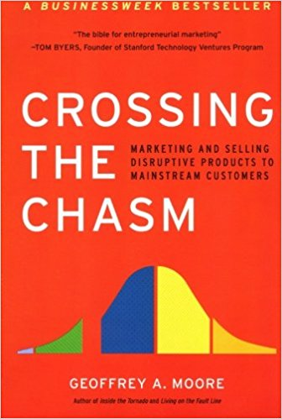
LF AI & Data Project Maturities
Adopting the same project maturity levels as other LF umbrellas
GRADUATED
LATE MAJORITY
“CONSERVATIVES”
“THE CHASM”
INCUBATING
INNOVATORS
“TECHIES”
SANDBOX
EARLY ADOPTERS
“VISIONARIES”
EARLY MAJORITY
“PRAGMATISTS”
LAGGARDS
“SKEPTICS”

